Slide 1




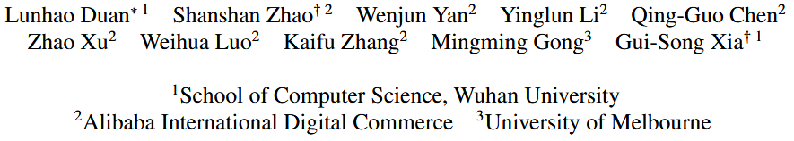



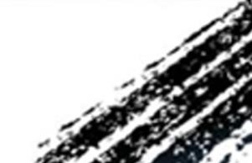

ATAI
Advanced Technique of Artificial Intelligence
ATAI
ChongqingUniversity _{AdvancedTechniqueof}
of Technology Artificial Intelligence
Chongqing University of Technology
Chongqing University ^{ATAI}
_{of Technology} Advanced Techniqueof
Artificial Intelligence
Chongqing University of Technology
Chongqing University of Technology
UNIC-Adapter: Unified Image-instruction Adapter with Multi-modal Transformer for Image Generation
code:NONE
—— CVPR ’25
Reported by Shu Ming Jiang
1

Slide 2
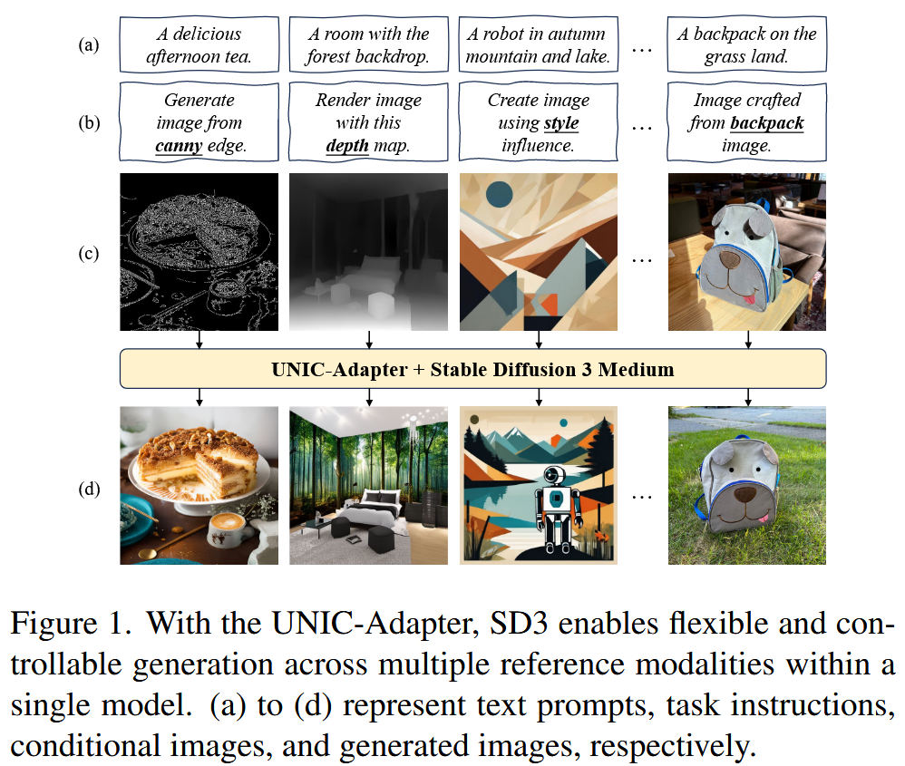
ATAI
Advanced Technique of
Artificial Intelligence
ATAI
ChongqingUniversity _{AdvancedTechniqueof}
of Technology Artificial Intelligence
Chongqing University of Technology
Motivation
1) Difficult to achieve precise control over pixel-level layouts, object appearances, and global styles when using text prompts alone, previous works introduce conditional images as auxiliary inputs for image generation, enhancing control but typically necessitating specialized models tailored to different types of reference inputs.

Slide 3
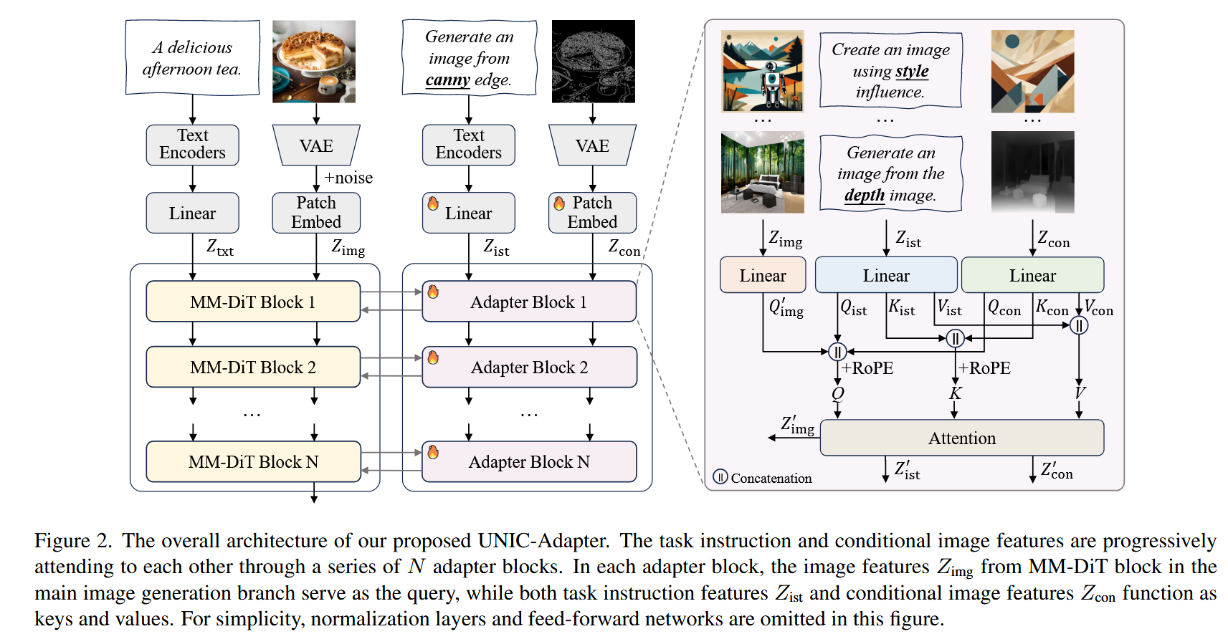
ATAI
Advanced Technique of
Artificial Intelligence
ATAI
ChongqingUniversity _{AdvancedTechniqueof}
of Technology Artificial Intelligence
Chongqing University of Technology
Overview

Slide 4
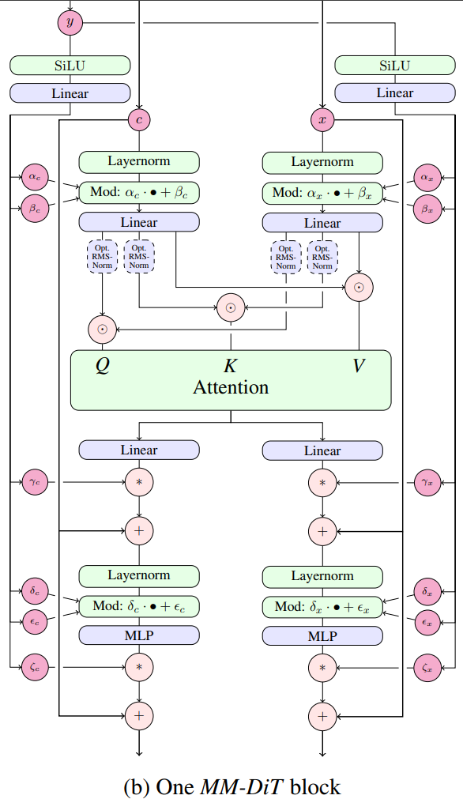
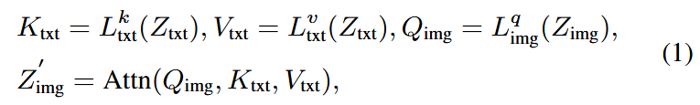
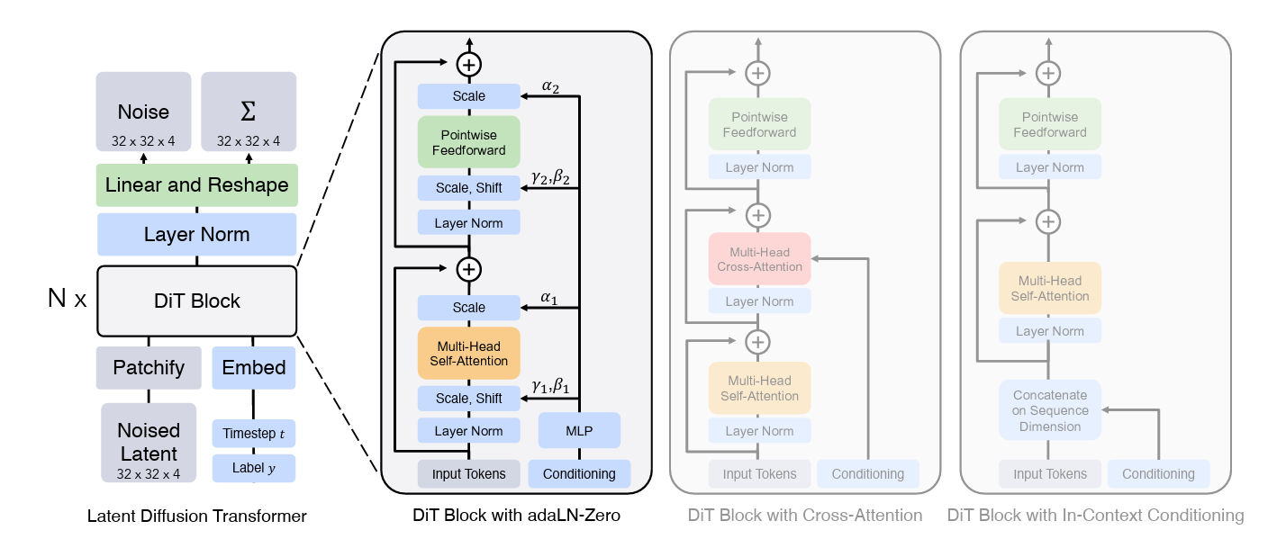
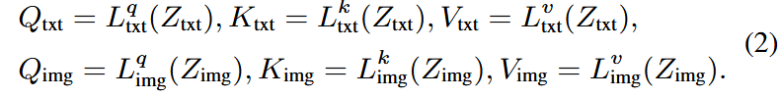
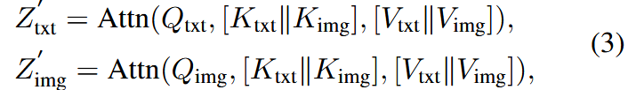
ATAI
Advanced Technique of
Artificial Intelligence
ATAI
ChongqingUniversity _{AdvancedTechniqueof}
of Technology Artificial Intelligence
Chongqing University of Technology
Method

Slide 5
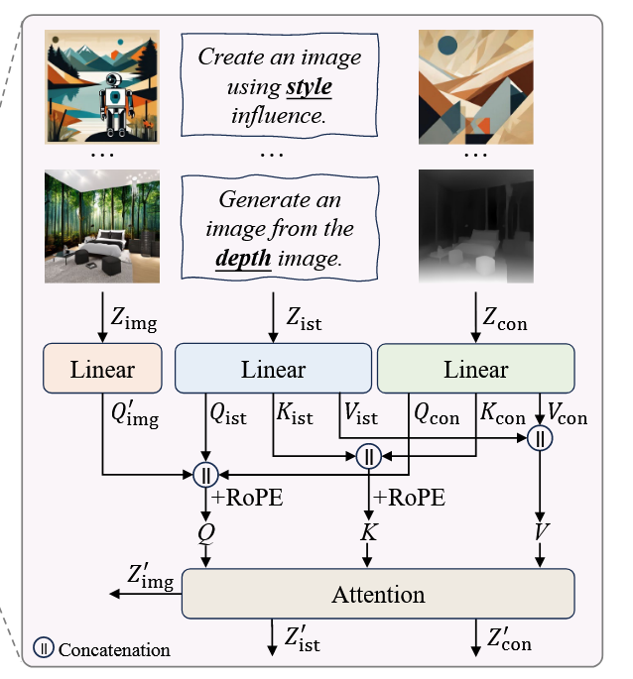
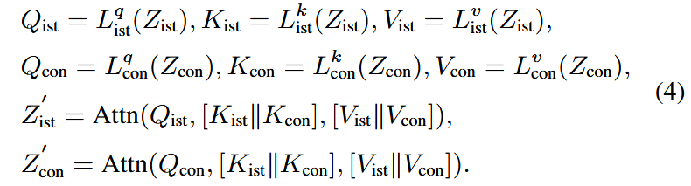
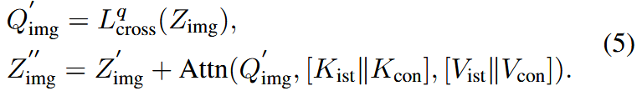
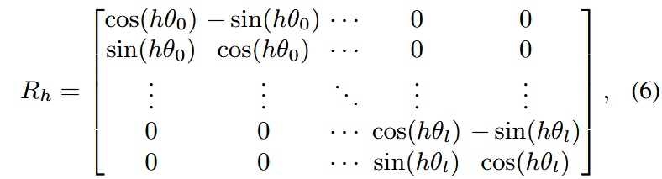
ATAI
Advanced Technique of
Artificial Intelligence
ATAI
ChongqingUniversity _{AdvancedTechniqueof}
of Technology Artificial Intelligence
Chongqing University of Technology
Method

Slide 6
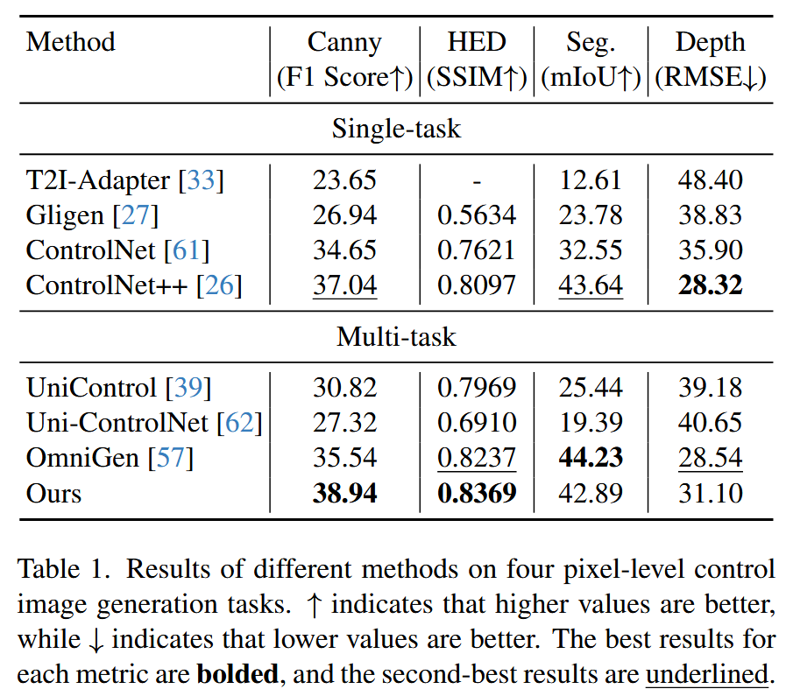
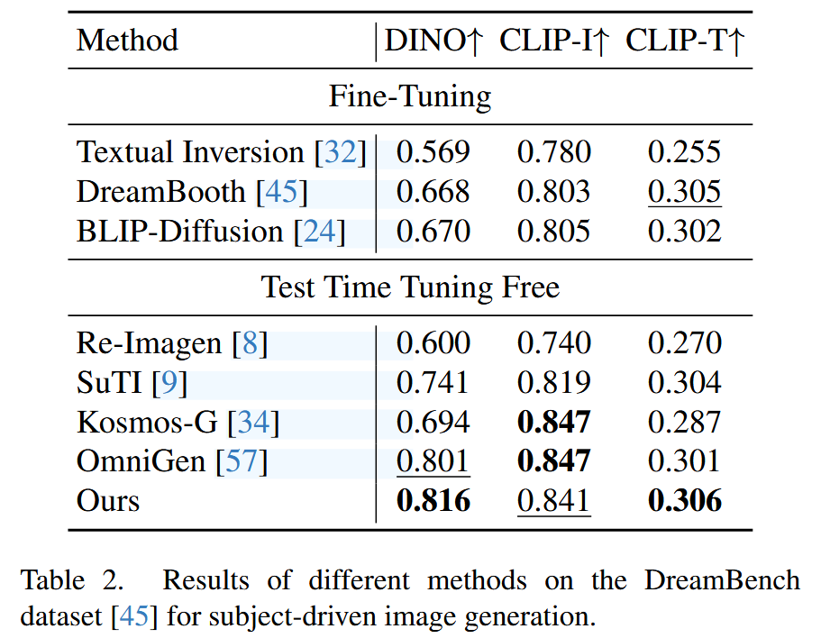
ATAI
Advanced Technique of
Artificial Intelligence
ATAI
ChongqingUniversity _{AdvancedTechniqueof}
of Technology Artificial Intelligence
Chongqing University of Technology
Experiments

Slide 7
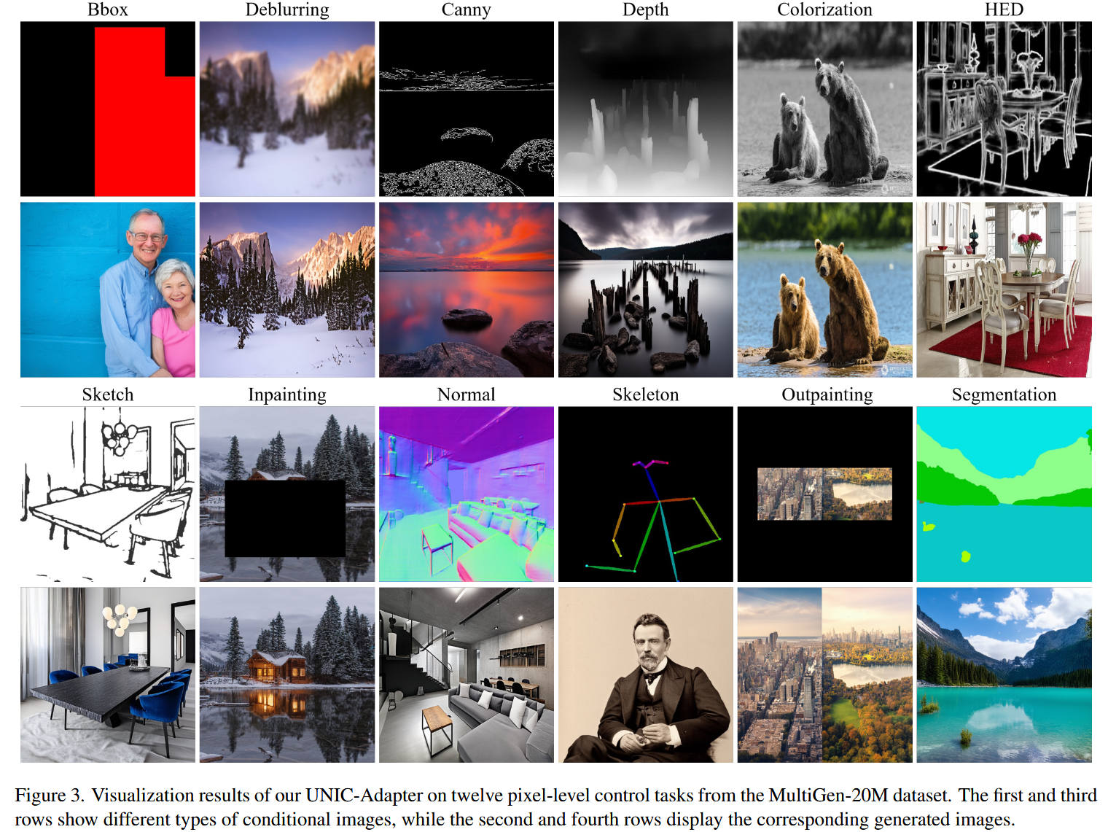
ATAI
Advanced Technique of
Artificial Intelligence
ATAI
ChongqingUniversity _{AdvancedTechniqueof}
of Technology Artificial Intelligence
Chongqing University of Technology
Experiments

Slide 8
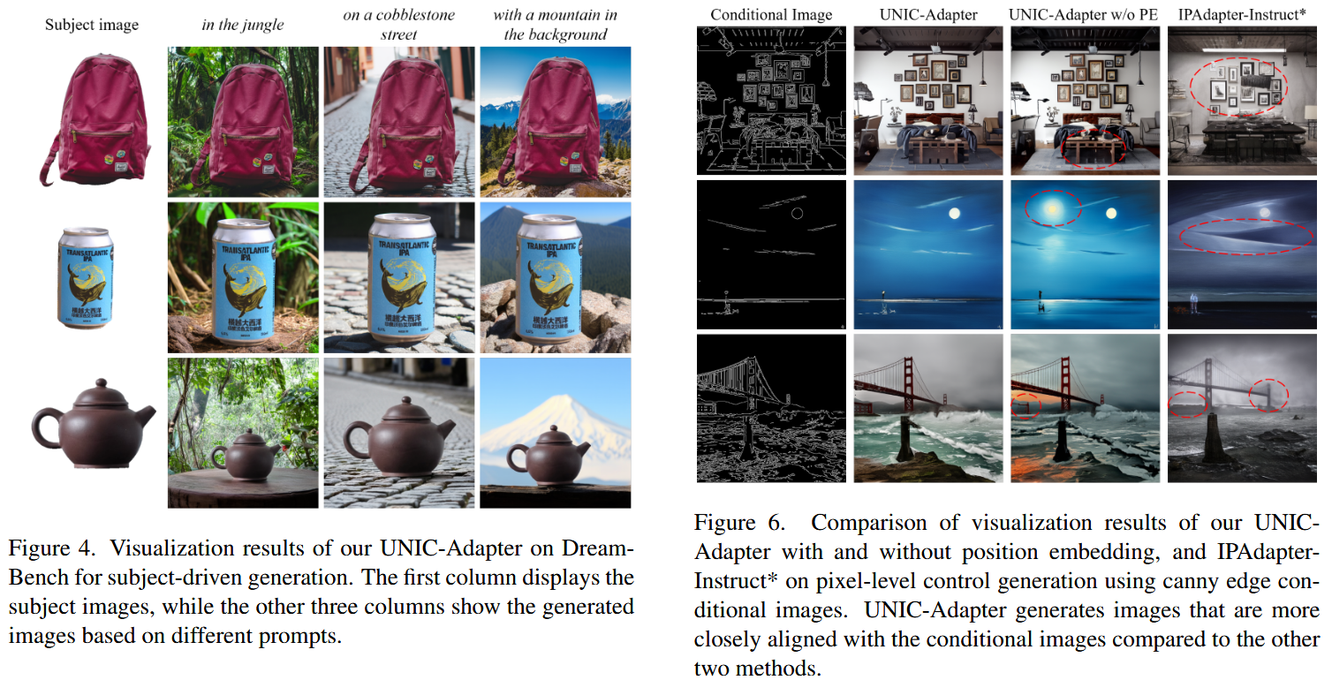
ATAI
Advanced Technique of
Artificial Intelligence
ATAI
ChongqingUniversity _{AdvancedTechniqueof}
of Technology Artificial Intelligence
Chongqing University of Technology
Experiments

Slide 9
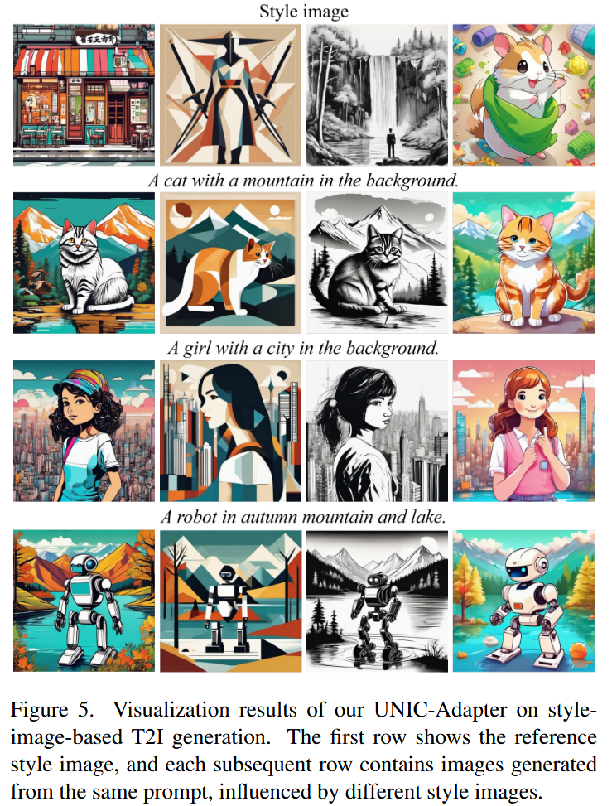
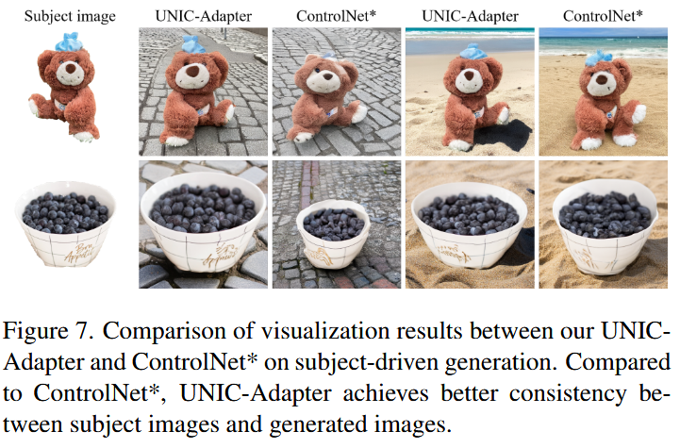
ATAI
Advanced Technique of
Artificial Intelligence
ATAI
ChongqingUniversity _{AdvancedTechniqueof}
of Technology Artificial Intelligence
Chongqing University of Technology
Experiments

Slide 10
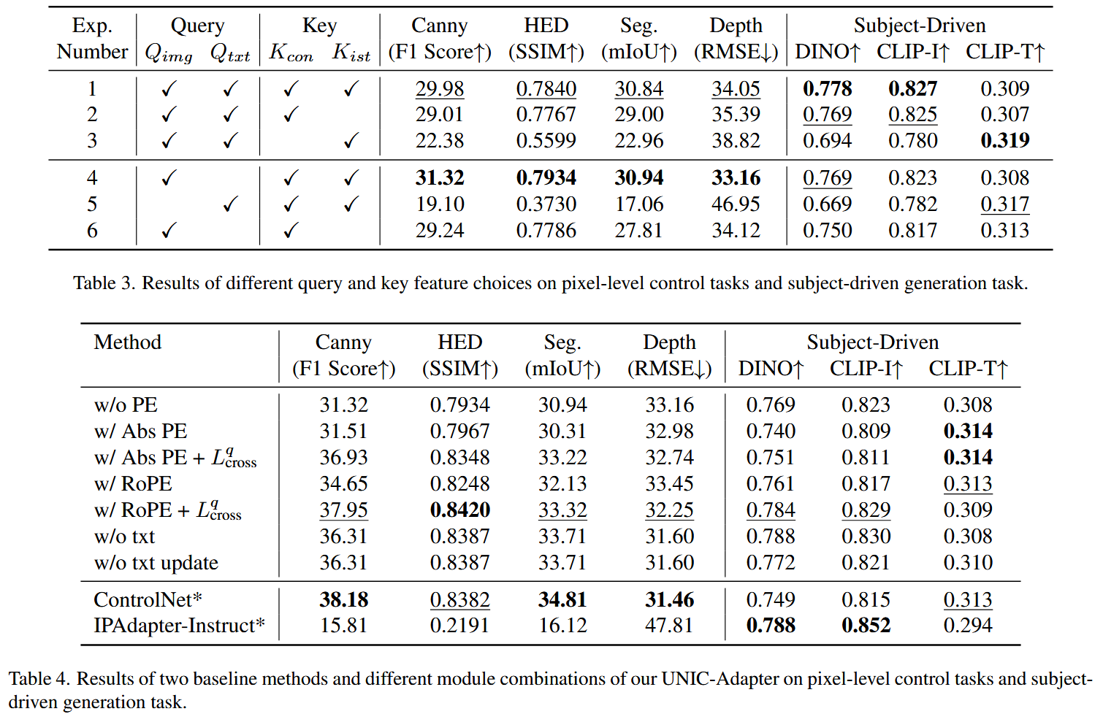
ATAI
Advanced Technique of
Artificial Intelligence
ATAI
ChongqingUniversity _{AdvancedTechniqueof}
of Technology Artificial Intelligence
Chongqing University of Technology
Experiments

Slide 11


ChongqingUniversity of Technology
ATAI
Advanced Technique of
Artificial Intelligence
ATAI
ChongqingUniversity _{AdvancedTechniqueof}
of Technology Artificial Intelligence
Chongqing University of Technology
Thanks!

